Slide 1
Artificial Neural Networks
Julia Ive
Queen Mary University of London
thanks to Joshua Reiss, Simon Dixon, Boris Mailhé and Alan Neymark
School of Electronic Engineering and Computer Science
Queen Mary University of London

Slide 2
Outline
Biological inspiration
Perceptron
Multilayer Perceptrons
Deep Learning
Training of Neural Networks
Convolutional Neural Networks

Slide 3
Learning Outcomes
Being able to draw a diagram of a basic perceptron and provide relevant equations
Perform perceptron training manually on paper given the training data
Being able to explain the advantage of having one or more hidden layers in an artificial neural network
Being able to provide formulas for cross-entropy loss, ReLU, Sigmoid activation and its derivative and explain them
Being able to explain the steps of the backpropagation algorithm in words
Perform gradient computation using backpropagation and weight updates on paper given formulas
Being able to compute dimensionalities of layers in a CNN network

Slide 4
Outline
Biological inspiration
Perceptron
Multilayer Perceptrons
Deep Learning
Training of Neural Networks
Convolutional Neural Networks

Slide 5
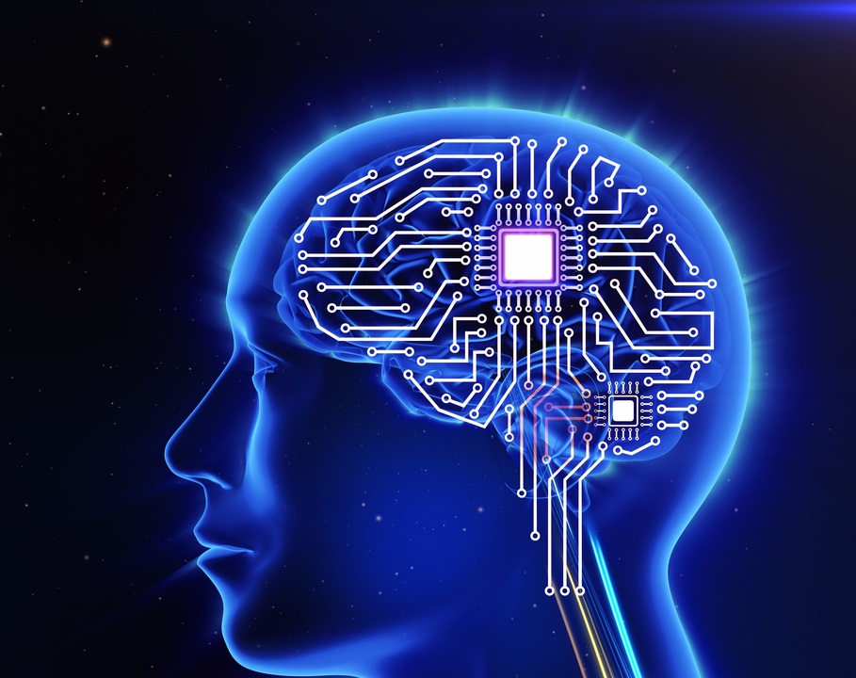
Motivation
AI is good at:
Can map input features into numerical values to outputs given large training data is provided
Fast computations in pre-defined scenarios
Humans are good at:
Transferring knowledge from one area to another
Find and understand additional features (properties that might be important) and quickly update their models
Understanding meaning of language
Can we build computers or programs that are more like brains?
If so, is it useful?

Slide 6
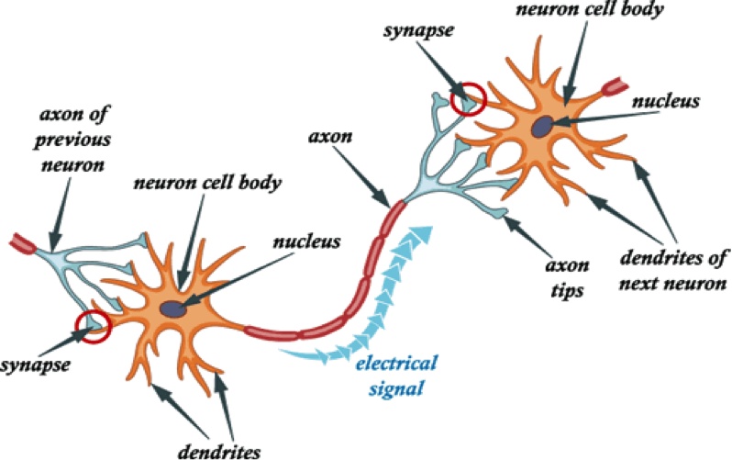
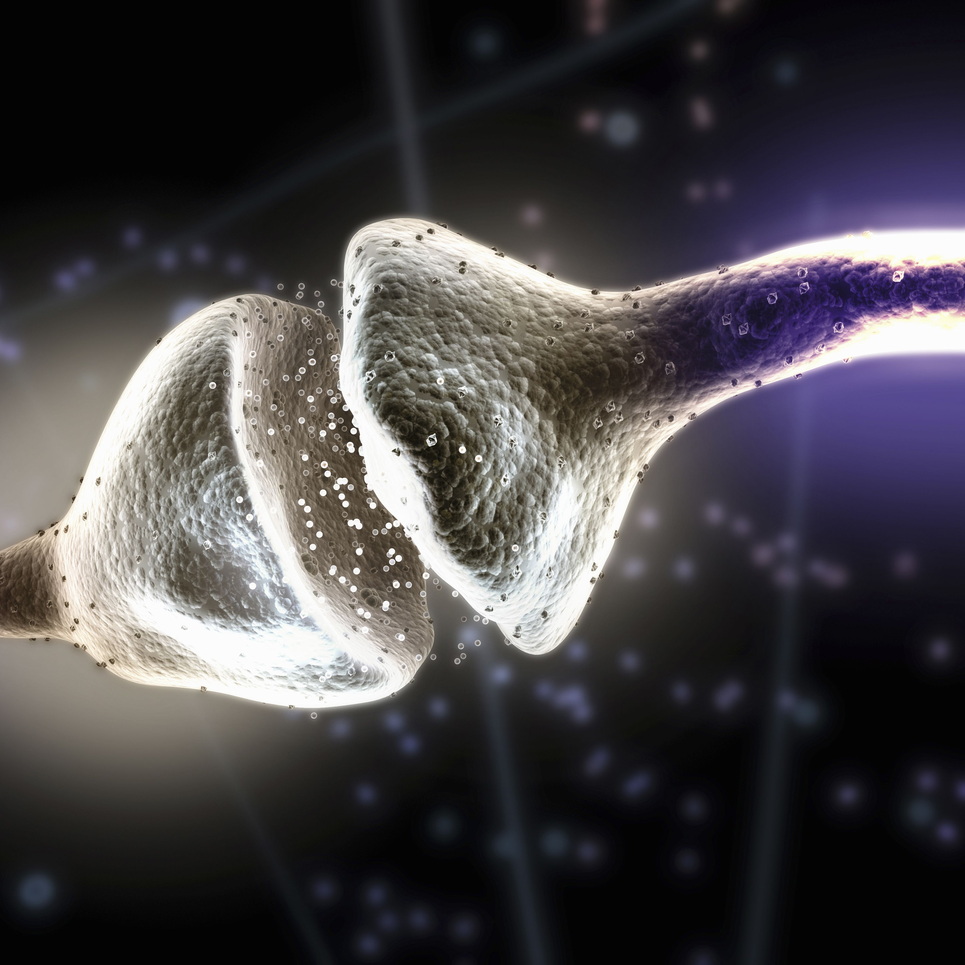
Human Brain: cell structure
Neurons –excitable brain cells forming a network
Axons of neurons (transmitters) connect to dendrites (receivers) of other neurons forming a synaptic connection
Synapse allows to pass an electrical or chemical signal (neurotransmitter) to another neuron
When potential reaches threshold, electrical pulse travels down axon eventually reaching all the branches causing them to release their neurotransmitters
https://www.thoughtco.com/neurotransmitters-definition-and-list-4151711

Slide 7
Outline
Biological inspiration
Perceptron
Multilayer Perceptrons
Deep Learning
Training of Neural Networks
Convolutional Neural Networks

Slide 8
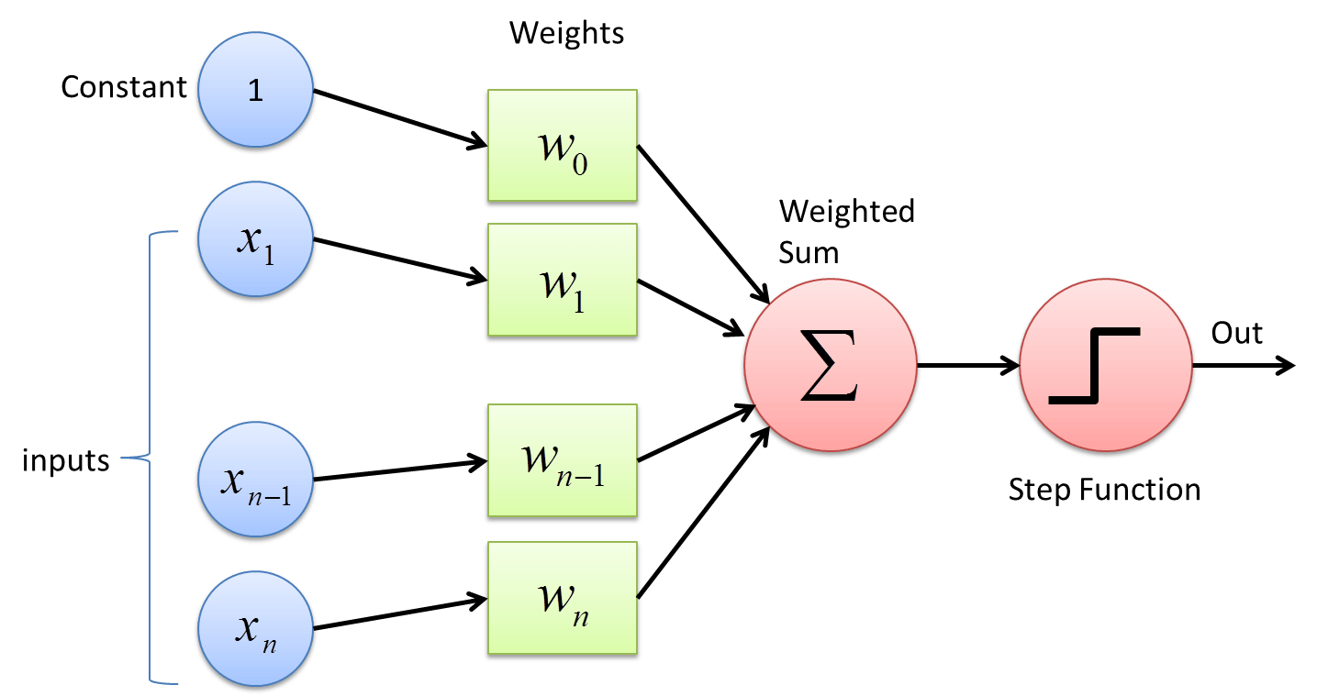
Perceptron
Neural Network is a collection of units, each of which has:
Inputs from other units represent degree to which they activate – anology: dendrites
Weights represent how much a unit is affected by activity of other units - anology: synapse
Threshold that sum of weighted inputs exceeds to cause firing
Single output that connects to inputs of other units - anology: axon

Slide 9
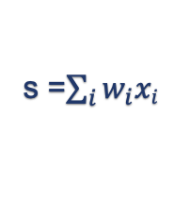
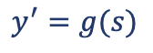
Perceptron: a perceptron unit
x1
w1
x2
w2
x3
w3
.
.
.
s =$\sum_{i}{w_{i}xi}$
$$y^{′}=g(s)$$
wn
xn
x_{i} are inputs (i<n), real numbers between 0 and 1
w_{i} are weights, real numbers
w_{n} is usually used for threshold, with xn = 1 (bias)
s is the weighted sum of inputs including the threshold (activation level)
y’ is the output
Output computed with g(.) that reflects how far perceptron’s activation level below or above 0

Slide 10
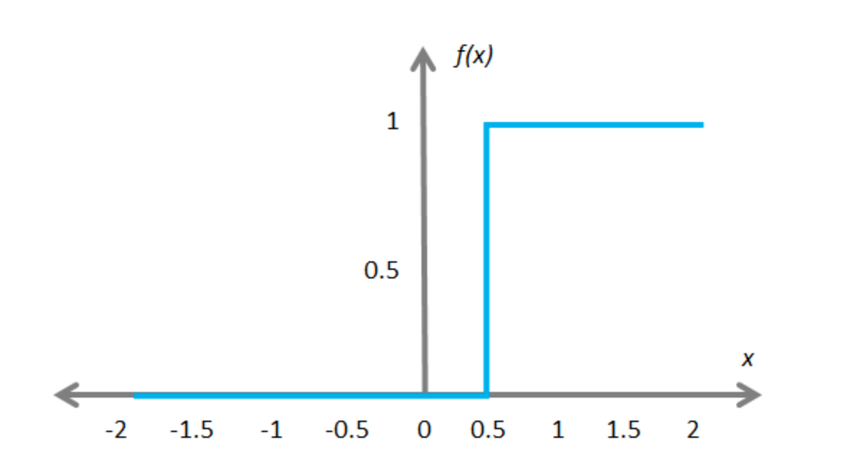
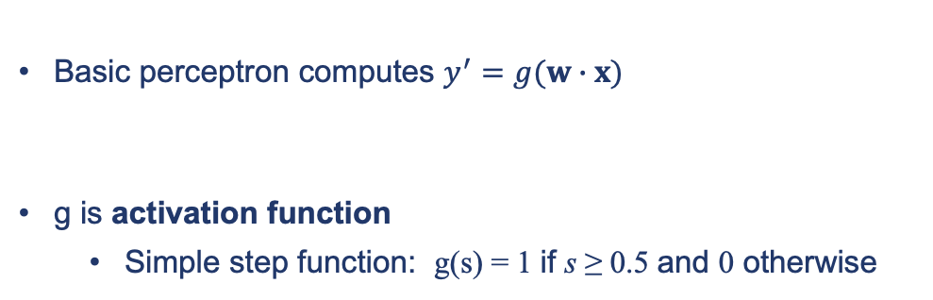
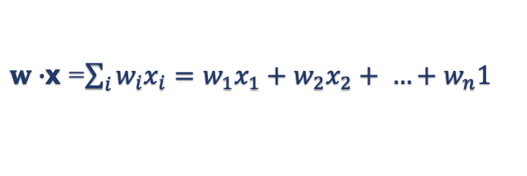
Perceptron: a perceptron unit
x1
w1
x2
w2
x3
w3
.
.
.
s =$\sum_{i}{w_{i}xi}$
$$y^{′}=g(s)$$
wn
xn
Basic perceptron computes $y^{′}=g(w∙x)$
g is activation function
Simple step function: g(s) = 1 if s ≥ 0.5 and 0 otherwise
$w∙$x =$\sum_{i}{w_{i}x_{i}=w_{1}x_{1}+w_{2}x_{2}+ …+w_{n}1}$

Slide 11
Hardwiring a perceptron
Perceptrons can simulate basic logic gates, such as AND
a
+1
b
+1
a ∧ b
a + b - 1
a | b | a + b - 1 | output
1 | 1 | 1 | 1
1 | 0 | 0 | 0
0 | 1 | 0 | 0
0 | 0 | -1 | 0
-1
1

Slide 12
Another example: logical OR
Changing one weight gives an OR gate
a
+1
b
+1
a ∨ b
a | b | a + b + 0 | output
1 | 1 | 2 | 1
1 | 0 | 1 | 1
0 | 1 | 1 | 1
0 | 0 | 0 | 0
a + b + 0
0
1
How did I know what to change? How can we do this in general?

Slide 13
Training perceptrons
Start with perceptron with any values for weights (usually random)
Choose an example, apply input, let perceptron compute the answer
If answer right
Do nothing
If answer wrong
Modify weights by adding or subtracting input vector
Add to increase the output, subtract to decrease it
Iterate over all input vectors, repeating as necessary, until perceptron learns what we want, within predefined error limit

Slide 14
Training the logical OR function
Initial weights all 0
weight vector, W = (0 0 0)
Cycle through inputs and change weights as necessary
a | b | bias | output
0 | 0 | 1 | 0
0 | 1 | 1 | 1
1 | 0 | 1 | 1
1 | 1 | 1 | 1

Slide 15
Training the logical OR function
Input Weights Result Action
(0 0 1) (0 0 0) 0 correct: change nothing
(0 1 1) (0 0 0) 0 should be 1, add Input to Weights
(1 0 1) 1 correct: change nothing
(1 1 1) (0 1 1) 1 correct: change nothing
(0 0 1) (0 1 1) 1 should be 0, subtract Input from Weights
(0 1 1) 1 correct: change nothing
(1 0 1) (0 1 0) 0 should be 1, add Input to Weights
(1 1 1) 1 correct: change nothing
(0 0 1) (1 1 1) 1 should be 0, subtract Input from Weights
(0 1 1) 1 correct: change nothing
(1 0 1) (1 1 0) 1 correct: change nothing
(1 1 1) (1 1 0) 1 correct: change nothing
(0 0 1) (1 1 0) 0 correct: change nothing
a | b | bias | out
0 | 0 | 1 | 0
0 | 1 | 1 | 1
1 | 0 | 1 | 1
1 | 1 | 1 | 1
(0 1 1)
(0 1 0)
(1 1 1)
(1 1 0)
complete correct epoch - cycle over the entire input data

Slide 16
Learning the logical AND function
Input Weights Result Action
(0 0 1) (0 0 0) 0 correct: change nothing
(0 1 1) (0 0 0) 0 correct: change nothing
(1 0 1) (0 0 0) 0 correct: change nothing
(1 1 1) (0 0 0) 0 should be 1, add Input to Weights
(0 0 1) (1 1 1) 1 should be 0, subtract Input from Weights
(0 1 1) (1 1 0) 1 should be 0, subtract Input from Weights
(1 0 1) (1 0 -1) 0 correct: change nothing
(1 1 1) (1 0 -1) 0 should be 1, add Input to Weights
(0 0 1) (2 1 0) 0 correct: change nothing
(0 1 1) (2 1 0) 1 should be 0, subtract Input from Weights
(1 0 1) (2 0 -1) 1 should be 0, subtract Input from Weights
(1 1 1) (1 0 -2) 0 should be 1, add Input to Weights
(0 0 1) (2 1 -1) 0 correct: change nothing
a | b | bias | output
0 | 0 | 1 | 0
0 | 1 | 1 | 0
1 | 0 | 1 | 0
1 | 1 | 1 | 1

Slide 17
Learning the logical AND function
a | b | bias | output
0 | 0 | 1 | 0
0 | 1 | 1 | 0
1 | 0 | 1 | 0
1 | 1 | 1 | 1
Input Weights Result Action
(0 0 1) (2 1 -1) 0 correct: change nothing
(0 1 1) (2 1 -1) 0 correct: change nothing
(1 0 1) (2 1 -1) 1 should be 0, subtract Input from Weights
(1 1 1) (1 1 -2) 0 should be 1, add Input to Weights
(0 0 1) (2 2 -1) 0 correct: change nothing
(0 1 1) (2 2 -1) 1 should be 0, subtract Input from Weights
(1 0 1) (2 1 -2) 0 correct: change nothing
(1 1 1) (2 1 -2) 1 correct: change nothing
(0 0 1) (2 1 -2) 0 correct: change nothing
(0 1 1) (2 1 -2) 0 correct: change nothing
complete correct epoch

Slide 18
Learning the logical AND function
Revisit last example with α = 0.2
a | b | bias | output
0 | 0 | 1 | 0
0 | 1 | 1 | 0
1 | 0 | 1 | 0
1 | 1 | 1 | 1
Input Weights Result Action
(0 0 1) (0 0 0) 0 correct: change nothing
(0 1 1) (0 0 0) 0 correct: change nothing
(1 0 1) (0 0 0) 0 correct: change nothing
(1 1 1) (0 0 0) 0 should have been 1, so add Input.α to Weights
(0 0 1) (0.2 0.2 0.2) 0 correct: change nothing
(0 1 1) (0.2 0.2 0.2) 0 correct: change nothing
(1 0 1) (0.2 0.2 0.2) 0 correct: change nothing
(1 1 1) (0.2 0.2 0.2) 1 correct: change nothing
complete correct epoch

Slide 19
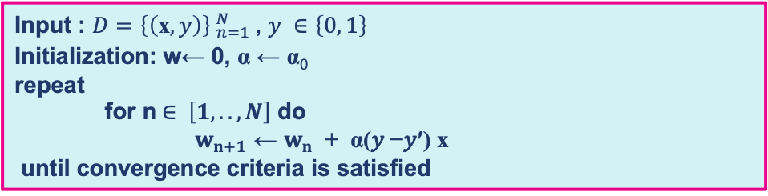
Perceptron training algorithm
Input : $D=\left\{\left(\text{x}, y\right)\right\}{ _{n=1}^{N}}_{ }$, $y ∈\left\{0, 1\right\}$
Initialization: w← 0, α ← α₀
repeat
for n$∈ \left[1, .., N\right]$ do
$w_{n+1}$ ← $w_{n}$ + α(𝑦 −𝑦′) x
until convergence criteria is satisfied
Learning rate, 0<α≤1, update step size that controls trade-off between speed and stability of convergence
Iterate over all input vectors, repeat until stopping criterion reached (weight vector converges - gives the correct response for all training patterns, or |Δw| ≤ given constant)

Slide 20
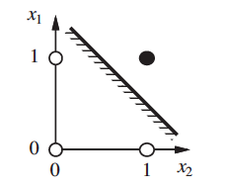
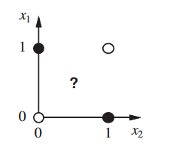
The bad news: the X-OR problem
A linearly separable function - AND
Single layer perceptron is computing a straight line between two linearly separable sets of points, dividing space in two
If no straight line partitions set, single perceptron cannot learn classification
Exclusive OR is one such case
Exclusive OR

Slide 21
Outline
Biological inspiration
Perceptron
Multilayer Perceptrons
Deep Learning
Training of Neural Networks
Convolutional Neural Networks

Slide 22
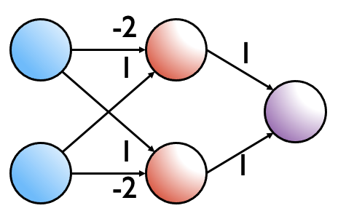
Multilayer Perceptrons
Exclusive OR
Solution: build neural networks from layers of perceptrons
So far, perceptron had two layers: one input and one output
We can use multiple layers
Universal Approximation Theorem has proven that network of 3 layers can approximate any function
This is one hidden layer of perceptrons
Cybenko’s theorem, 1989, for sigmoid activation; Hornik, 1991, generalised

Slide 23
Multilayer Perceptron
Hidden Layer
Example with 1 hidden fully-connected (affine) layer
Each neuron connected to all neurons of next layer
The values of h are transformed by a non-linear function g that is applied to each value before being passed on to the next layer
w₁
x₁
h₁
w₅
w₂
o
x₂
w₃
h₂
w₆
w₄
Input Layer
Output Layer

Slide 24
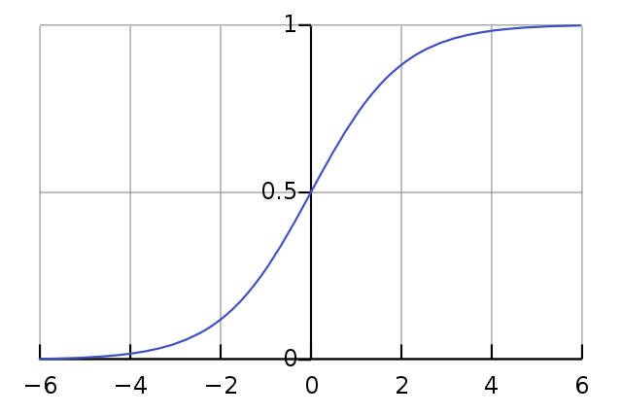
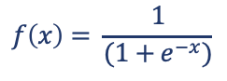
Multilayer Perceptron
Popular activation – sigmoid
Outputs values in the range 0 to 1 – good for probability prediction
May cause the vanishing gradient problem
Hidden Layer
w₁
x₁
h₁
w₅
w₂
o
$$f\left(x\right)= \frac{1}{(1+e^{−x})}$$
x₂
w₃
h₂
w₆
w₄
Input Layer
Output Layer

Slide 25
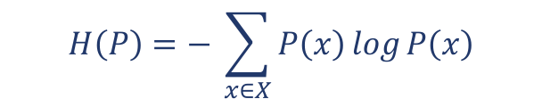
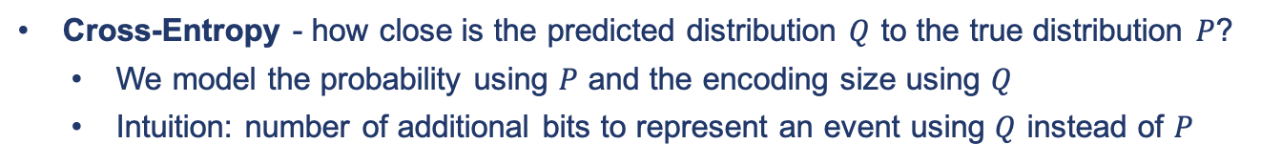
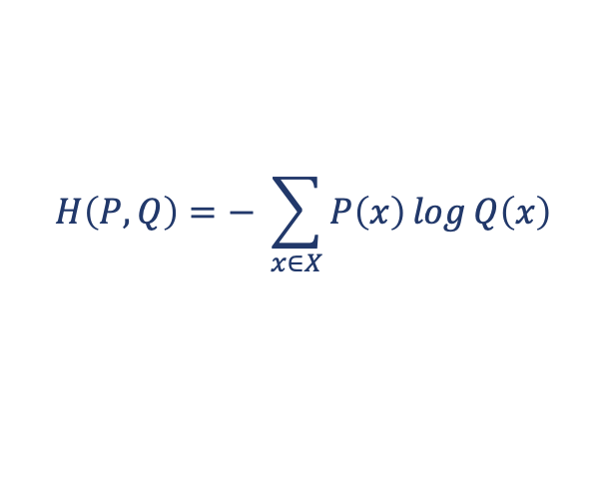
Cross-Entropy Loss
Optimisation algorithm aims to adjust parameter values to minimise error or loss
Loss functions L(y’,y) state the loss (a scalar) of predicting y’ when the true output is y
For classification tasks we usually use cross-entropy (negative log-likelihood)
Recall entropy:
$$H\left(P\right)=− \sum_{x∈X}^{ }{P\left(x\right)⁡\log_{ }P\left(x\right)}$$
Cross-Entropy - how close is the predicted distribution $Q$ to the true distribution $P$?
We model the probability using $P$ and the encoding size using $Q$
Intuition: number of additional bits to represent an event using $Q$ instead of $P$
$$H\left(P, Q\right)=− \sum_{x∈X}^{ }{P\left(x\right)⁡\log_{ }Q\left(x\right)}$$

Slide 26
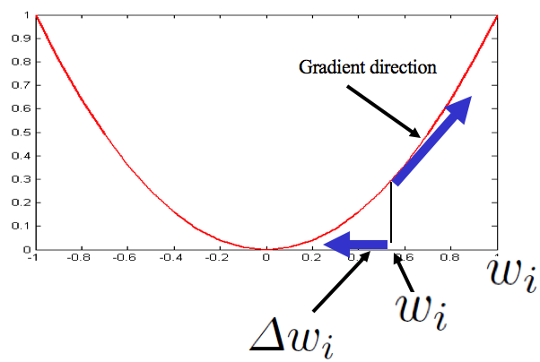
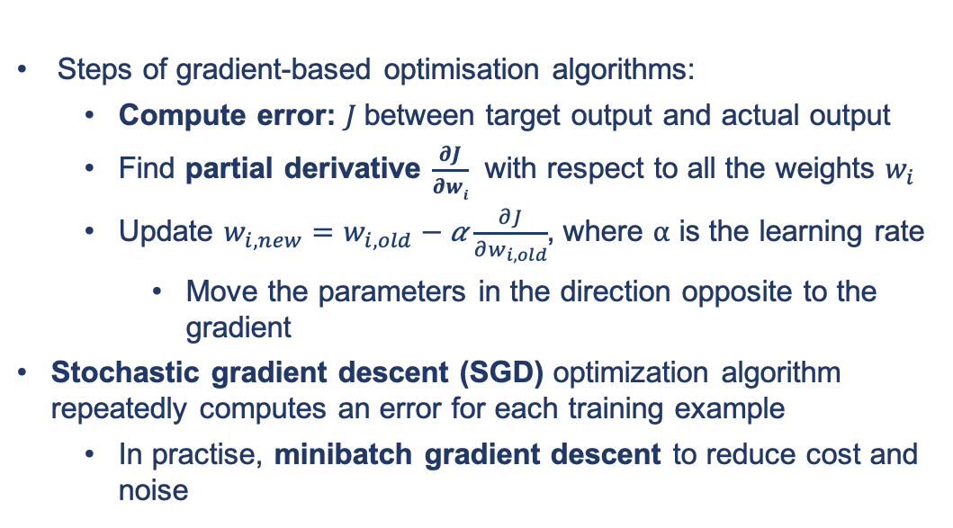
Parameters
Steps of gradient-based optimisation algorithms:
Compute error: $J$between target output and actual output
Find partial derivative $\frac{∂J}{∂wi}$ with respect to all the weights $w_{i}$
Update $w_{i, new}=w_{i, old}−\text{α}\frac{∂J}{∂w_{i, old}}$, where ⍺ is the learning rate
Move the parameters in the direction opposite to the gradient
Stochastic gradient descent (SGD) optimization algorithm repeatedly computes an error for each training example
In practise, minibatch gradient descent to reduce cost and noise
How do we do it?
J

Slide 27
Backpropagation
Backpropagation algorithm - automatic differentiation algorithm for calculating gradients for the weights in a neural network
Main principles:
Use the chain rule to find the derivatives of composite functions
Re-use derivatives computed for higher layers in computing derivatives for lower layers to minimize computation

Slide 28
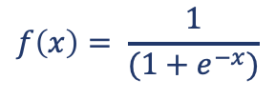
Training example
Inputs
x₁=1
x₂=1
Target
o=0
Initial Weights
w₁=-2 w₃=1
w₂=1 w₄=-1
w₅=1 w₆=1
Learning rate
⍺ =1
w₁
x₁
h₁
w₅
w₂
o
x₂
w₃
h₂
w₆
w₄
We use sigmoid as the activation function
$$f\left(x\right)= \frac{1}{(1+e^{−x})}$$

Slide 29
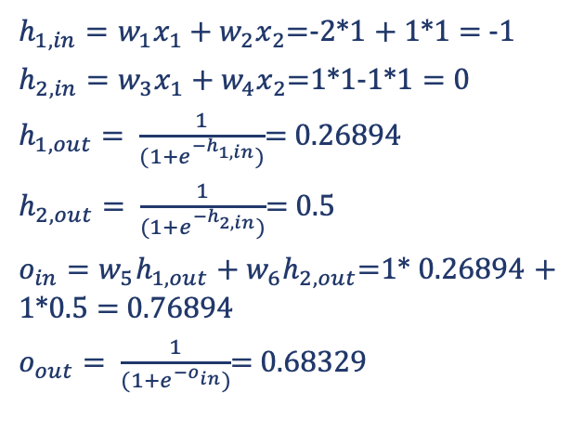
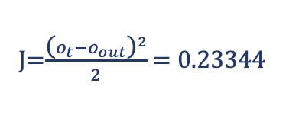






Training example: Forward pass
$$h_{1,in}$$
$$h_{1,out}$$
$h_{1,in}=w_{1}x_{1}+$ $w_{2}x_{2}$=-2*1 + 1*1 = -1
$h_{2, in}=w_{3}x_{1}+$ $w_{4}x_{2}$=1*1-1*1 = 0
$h_{1, out}= \frac{1}{(1+e^{−h_{1,in}})}$= 0.26894
$h_{2, out}= \frac{1}{(1+e^{−h_{2,in}})}$= 0.5
$o_{in}=w_{5}h_{1,out}+$ $w_{6}h_{2, out}$=1* 0.26894 + 1*0.5 = 0.76894
$o_{out}= \frac{1}{(1+e^{−o_{in}})}$= 0.68329
w₁
x₁
h₁
w₅
w₂
$$o_{in}$$
o
$$o_{out}$$
x₂
w₃
h₂
w₆
w₄
$$h_{2,in}$$
$$h_{2,out}$$
Squared error function
Inputs
x₁=1
x₂=1
Target
o=0
Initial Weights
w₁=-2 w₃=1
w₂=1 w₄=-1
w₅=1 w₆=1
Learning rate
⍺ =1
J=$\frac{{\text{(}o_{t}−o_{out}\text{)}}^{2}}{2}$ = 0.23344

Slide 30
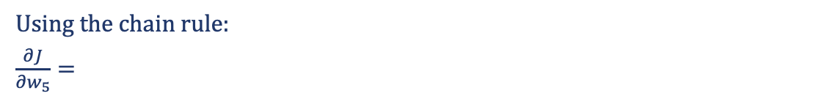
Training example: Backward pass
w₁
x₁
h₁
w₅
w₂
o_{in} o_{out}
J
x₂
w₃
h₂
w₄
w₆
Using the chain rule:
$\frac{∂J}{∂w_{5}}=$
Inputs
x₁=1
x₂=1
Target
o=0
Initial Weights
w₁=-2 w₃=1
w₂=1 w₄=-1
w₅=1 w₆=1
Learning rate
a=1

Slide 31
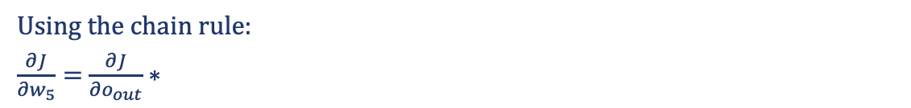
Training example: Backward pass
w₁
x₁
h₁
w₅
w₂
o_{in} o_{out}
J
x₂
w₃
h₂
w₄
w₆
Using the chain rule:
$\frac{∂J}{∂w_{5}}=$ $\frac{∂J}{∂o_{out}}∗$
Inputs
x₁=1
x₂=1
Target
o=0
Initial Weights
w₁=-2 w₃=1
w₂=1 w₄=-1
w₅=1 w₆=1
Learning rate
a=1

Slide 32
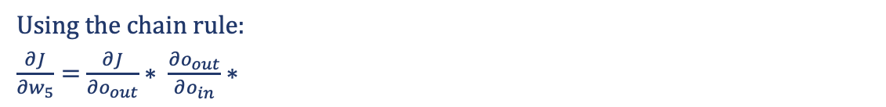
Training example: Backward pass
w₁
x₁
h₁
w₅
w₂
o_{in} o_{out}
J
x₂
w₃
h₂
w₄
w₆
Using the chain rule:
$\frac{∂J}{∂w_{5}}=$ $\frac{∂J}{∂o_{out}}∗ \frac{∂o_{out}}{∂o_{in}}∗$
Inputs
x₁=1
x₂=1
Target
o=0
Initial Weights
w₁=-2 w₃=1
w₂=1 w₄=-1
w₅=1 w₆=1
Learning rate
a=1

Slide 33
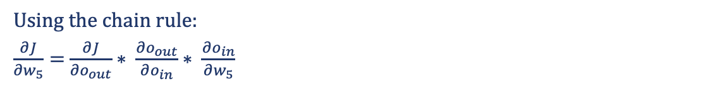
Training example: Backward pass
w₁
x₁
h₁
w₅
w₂
o_{in} o_{out}
J
x₂
w₃
h₂
w₄
w₆
Using the chain rule:
$\frac{∂J}{∂w_{5}}=$ $\frac{∂J}{∂o_{out}}∗ \frac{∂o_{out}}{∂o_{in}}∗ \frac{∂o_{in}}{∂w_{5}}$
Inputs
x₁=1
x₂=1
Target
o=0
Initial Weights
w₁=-2 w₃=1
w₂=1 w₄=-1
w₅=1 w₆=1
Learning rate
a=1

Slide 34
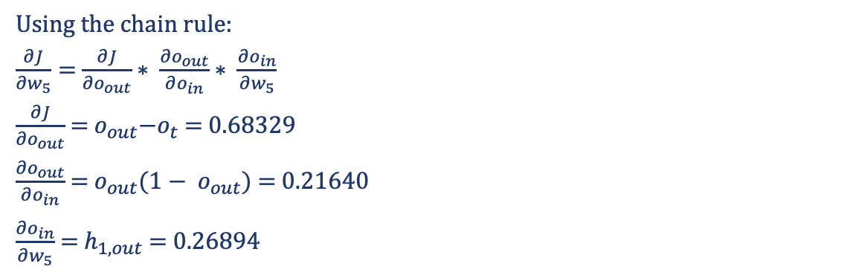
Training example: Backward pass
w₁
x₁
h₁
w₅
w₂
o_{in} o_{out}
J
x₂
w₃
h₂
w₄
w₆
Using the chain rule:
$\frac{∂J}{∂w_{5}}=$ $\frac{∂J}{∂o_{out}}∗ \frac{∂o_{out}}{∂o_{in}}∗ \frac{∂o_{in}}{∂w_{5}}$
$\frac{∂J}{∂o_{out}}$ =${ o}_{out}−o_{t}$ = 0.68329
$\frac{∂o_{out}}{∂o_{in}}$ = $o_{out}{(1− o}_{out})$ = 0.21640
$\frac{∂o_{in}}{∂w_{5}}$ = $h_{1, out}$ = 0.26894
Inputs
x₁=1
x₂=1
Target
o=0
Initial Weights
w₁=-2 w₃=1
w₂=1 w₄=-1
w₅=1 w₆=1
Learning rate
a=1

Slide 35
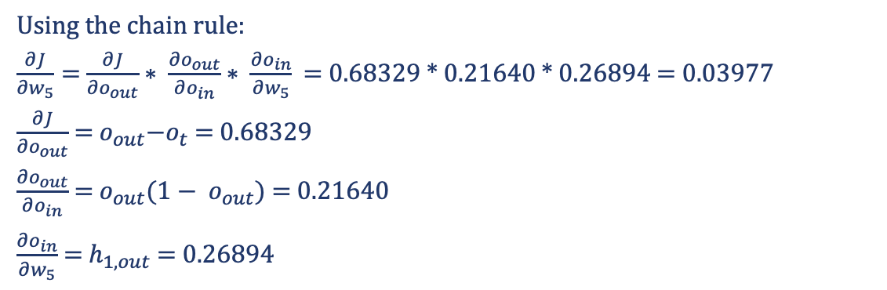
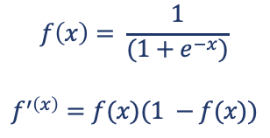
Training example: Backward pass
w₁
Recall:
x₁
h₁
$$f\left(x\right)= \frac{1}{(1+e^{−x})}$$
$$f^{′\left(x\right)}=f(x)(1 −f(x))$$
w₅
w₂
o_{in} o_{out}
J
x₂
w₃
h₂
w₄
w₆
Using the chain rule:
$\frac{∂J}{∂w_{5}}=$ $\frac{∂J}{∂o_{out}}∗ \frac{∂o_{out}}{∂o_{in}}∗ \frac{∂o_{in}}{∂w_{5}}$ = 0.68329 * 0.21640 * 0.26894 = 0.03977
$\frac{∂J}{∂o_{out}}$ =${ o}_{out}−o_{t}$ = 0.68329
$\frac{∂o_{out}}{∂o_{in}}$ = $o_{out}{(1− o}_{out})$ = 0.21640
$\frac{∂o_{in}}{∂w_{5}}$ = $h_{1, out}$ = 0.26894
Inputs
x₁=1
x₂=1
Target
o=0
Initial Weights
w₁=-2 w₃=1
w₂=1 w₄=-1
w₅=1 w₆=1
Learning rate
a=1

Slide 36
Training example: Backward pass
w₁
x₁
h₁
w₅
w₂
o_{in} o_{out}
J
x₂
w₃
h₂
w₄
w₆
Using the chain rule:
$\frac{∂J}{∂w_{5}}=$ $\frac{∂J}{∂o_{out}}∗ \frac{∂o_{out}}{∂o_{in}}∗ \frac{∂o_{in}}{∂w_{5}}$ = 0.68329 * 0.21640 * 0.26894 = 0.03977
$\frac{∂J}{∂o_{out}}$ =${ o}_{out}−o_{t}$ = 0.68329
$\frac{∂o_{out}}{∂o_{in}}$ = $o_{out}{(1− o}_{out})$ = 0.21640
$\frac{∂o_{in}}{∂w_{5}}$ = $h_{1, out}$ = 0.26894
Inputs
x₁=1
x₂=1
Target
o=0
Initial Weights
w₁=-2 w₃=1
w₂=1 w₄=-1
w₅=1 w₆=1
Learning rate
a=1
Delta value 𝛿 : error signal
Local input signal

Slide 37
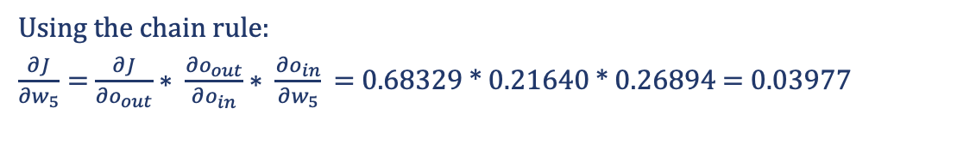
Training example: Backward pass
w₁
x₁
h₁
w₅
w₂
o_{in} o_{out}
Local input signal
J
x₂
w₃
h₂
w₆
w₄
Using the chain rule:
$\frac{∂J}{∂w_{5}}=$ $\frac{∂J}{∂o_{out}}∗ \frac{∂o_{out}}{∂o_{in}}∗ \frac{∂o_{in}}{∂w_{5}}$ = 0.68329 * 0.21640 * 0.26894 = 0.03977
Inputs
x₁=1
x₂=1
Target
o=0
Initial Weights
w₁=-2 w₃=1
w₂=1 w₄=-1
w₅=1 w₆=1
Learning rate
⍺ =1
Delta value 𝛿 = observed error * derivative of activation function

Slide 38
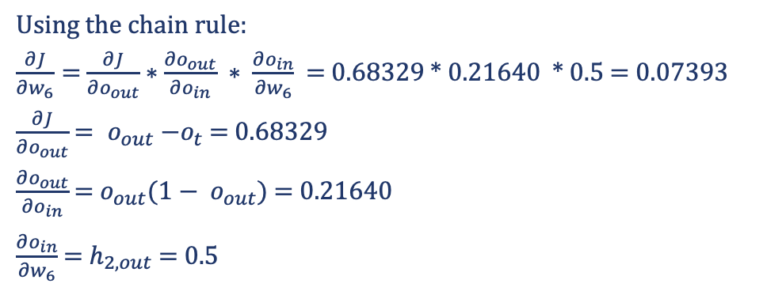
Training example: Backward pass
w₁
x₁
h₁
w₅
w₂
o_{in} o_{out}
w₃
J
x₂
h₂
w₆
w₄
Using the chain rule:
$\frac{∂J}{∂w_{6}}=$ $\frac{∂J}{∂o_{out}}∗$ $\frac{∂o_{out}}{∂o_{in}} ∗ \frac{∂o_{in}}{∂w_{6}}$ = 0.68329 * 0.21640 * 0.5 = 0.07393
$\frac{∂J}{∂o_{out}}$ = ${ o}_{out} −o_{t}$ = 0.68329
$\frac{∂o_{out}}{∂o_{in}}$ = $o_{out}{(1− o}_{out})$ = 0.21640
$\frac{∂o_{in}}{∂w_{6}}$ = $h_{2, out}$ = 0.5
Inputs
x₁=1
x₂=1
Target
o=0
Initial Weights
w₁=-2 w₃=1
w₂=1 w₄=-1
w₅=1 w₆=1
Learning rate
⍺ =1

Slide 39
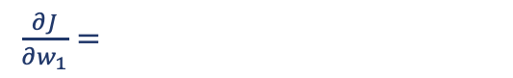
Training example: Backward pass
w₁
h_{1,in} h_{1,out}
x₁
w₅
w₂
$\frac{∂J}{∂w_{1}}=$
o
x₂
w₃
w₆
J
w₄
h₂
Inputs
x₁=1
x₂=1
Target
o=0
Initial Weights
w₁=-2 w₃=1
w₂=1 w₄=-1
w₅=1 w₆=1
Learning rate
⍺ =1

Slide 40
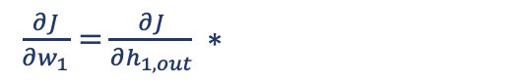
Training example: Backward pass
w₁
h_{1,in} h_{1,out}
x₁
w₅
w₂
$\frac{∂J}{∂w_{1}}=$ $\frac{∂J}{∂h_{1,out}} ∗$
o
x₂
w₃
w₆
J
w₄
h₂
Inputs
x₁=1
x₂=1
Target
o=0
Initial Weights
w₁=-2 w₃=1
w₂=1 w₄=-1
w₅=1 w₆=1
Learning rate
⍺ =1

Slide 41
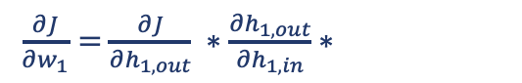
Training example: Backward pass
w₁
h_{1,in} h_{1,out}
x₁
w₅
w₂
$\frac{∂J}{∂w_{1}}=$ $\frac{∂J}{∂h_{1,out}} ∗\frac{∂h_{1,out}}{∂h_{1,in}}∗$
o
x₂
w₃
w₆
J
w₄
h₂
Inputs
x₁=1
x₂=1
Target
o=0
Initial Weights
w₁=-2 w₃=1
w₂=1 w₄=-1
w₅=1 w₆=1
Learning rate
⍺ =1

Slide 42
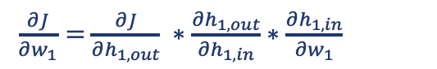
Training example: Backward pass
w₁
h_{1,in} h_{1,out}
x₁
w₅
w₂
$\frac{∂J}{∂w_{1}}=$ $\frac{∂J}{∂h_{1,out}} ∗\frac{∂h_{1,out}}{∂h_{1,in}}∗\frac{∂h_{1,in}}{∂w_{1}}$
o
x₂
w₃
w₆
J
w₄
h₂
Inputs
x₁=1
x₂=1
Target
o=0
Initial Weights
w₁=-2 w₃=1
w₂=1 w₄=-1
w₅=1 w₆=1
Learning rate
⍺ =1

Slide 43
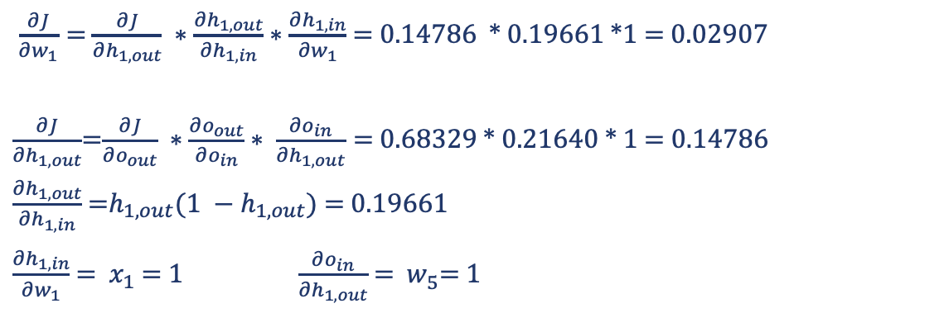
Training example: Backward pass
w₁
h_{1,in} h_{1,out}
x₁
w₅
w₂
$\frac{∂J}{∂w_{1}}=$ $\frac{∂J}{∂h_{1,out}} ∗\frac{∂h_{1,out}}{∂h_{1,in}}∗\frac{∂h_{1,in}}{∂w_{1}}$ = 0.14786 * 0.19661 *1 = 0.02907
$\frac{∂J}{∂h_{1,out}}$=$\frac{∂J}{∂o_{out}} ∗\frac{∂o_{out}}{∂o_{in}}∗ \frac{∂o_{in}}{∂h_{1,out}}=$ 0.68329 * 0.21640 * 1 = 0.14786
$\frac{∂h_{1,out}}{∂h_{1,in}}$ =$h_{1,out}(1 −h_{1,out})$ = 0.19661
$\frac{∂h_{1,in}}{∂w_{1}}$ = ${ x}_{1}$ = 1 $\frac{∂o_{in}}{∂h_{1,out}}$ = $w_{5}^{ }$= 1
o
x₂
w₃
w₆
J
w₄
h₂
Inputs
x₁=1
x₂=1
Target
o=0
Initial Weights
w₁=-2 w₃=1
w₂=1 w₄=-1
w₅=1 w₆=1
Learning rate
⍺ =1

Slide 44
Training example: Backward pass
Derivative of activation function
w₁
h_{1,in} h_{1,out}
x₁
w₅
w₂
$\frac{∂J}{∂w_{1}}=$ $\frac{∂J}{∂h_{1,out}} ∗\frac{∂h_{1,out}}{∂h_{1,in}}∗\frac{∂h_{1,in}}{∂w_{1}}$ = 0.14786 * 0.19661 *1 = 0.02907
$\frac{∂J}{∂h_{1,out}}$=$\frac{∂J}{∂o_{out}} ∗\frac{∂o_{out}}{∂o_{in}}∗ \frac{∂o_{in}}{∂h_{1,out}}=$ 0.68329 * 0.21640 * 1 = 0.14786
$\frac{∂h_{1,out}}{∂h_{1,in}}$ =$h_{1,out}(1 −h_{1,out})$ = 0.19661
$\frac{∂h_{1,in}}{∂w_{1}}$ = ${ x}_{1}$ = 1 $\frac{∂o_{in}}{∂h_{1,out}}$ = $w_{5}^{ }$= 1
o
x₂
w₃
Observed error
w₆
J
w₄
h₂
Inputs
x₁=1
x₂=1
Target
o=0
Initial Weights
w₁=-2 w₃=1
w₂=1 w₄=-1
w₅=1 w₆=1
Learning rate
⍺ =1

Slide 45
Training example: Backward pass
Derivative of activation function
w₁
h_{1,in} h_{1,out}
x₁
w₅
w₂
$\frac{∂J}{∂w_{1}}=$ $\frac{∂J}{∂h_{1,out}} ∗\frac{∂h_{1,out}}{∂h_{1,in}}∗\frac{∂h_{1,in}}{∂w_{1}}$ = 0.14786 * 0.19661 *1 = 0.02907
$\frac{∂J}{∂h_{1,out}}$=$\frac{∂J}{∂o_{out}} ∗\frac{∂o_{out}}{∂o_{in}}∗ \frac{∂o_{in}}{∂h_{1,out}}=$ 0.68329 * 0.21640 * 1 = 0.14786
$\frac{∂h_{1,out}}{∂h_{1,in}}$ =$h_{1,out}(1 −h_{1,out})$ = 0.19661
$\frac{∂h_{1,in}}{∂w_{1}}$ = ${ x}_{1}$ = 1 $\frac{∂o_{in}}{∂h_{1,out}}$ = $w_{5}^{ }$= 1
o
x₂
w₃
w₆
J
w₄
h₂
Inputs
x₁=1
x₂=1
Target
o=0
Initial Weights
w₁=-2 w₃=1
w₂=1 w₄=-1
w₅=1 w₆=1
Learning rate
⍺ =1

Slide 46
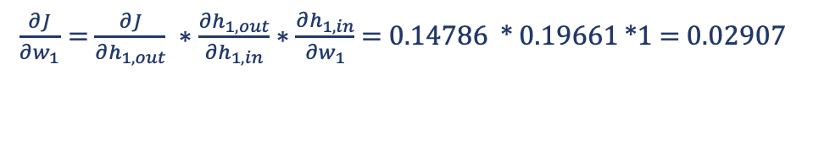
Training example: Backward pass
w₁
h_{1,in} h_{1,out}
x₁
w₅
w₂
Delta values 𝛿 : weighted error at the next layer * derivative of activation function
Local input signal
o
x₂
w₃
w₆
J
w₄
h₂
$\frac{∂J}{∂w_{1}}=$ $\frac{∂J}{∂h_{1,out}} ∗\frac{∂h_{1,out}}{∂h_{1,in}}∗\frac{∂h_{1,in}}{∂w_{1}}$ = 0.14786 * 0.19661 *1 = 0.02907
Initial Weights
w₁=-2 w₃=1
w₂=1 w₄=-1
w₅=1 w₆=1
Learning rate
⍺ =1
Inputs
x₁=1
x₂=1
Target
o=0

Slide 47
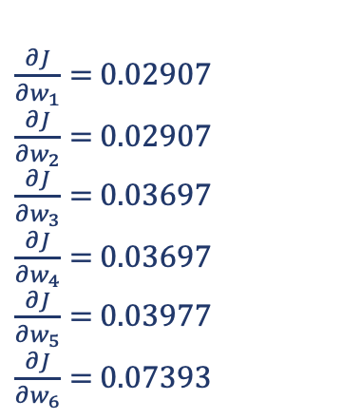
Training example: Backward pass
$\frac{∂J}{∂w_{1}}=$ $0.02907$
$\frac{∂J}{∂w_{2}}=$ $0.02907$
$\frac{∂J}{∂w_{3}}=$ $0.03697$
$\frac{∂J}{∂w_{4}}=$ $0.03697$
$\frac{∂J}{∂w_{5}}=$ 0.03977
$\frac{∂J}{∂w_{6}}=$ 0.07393
w₁
x₁
h₁
w₅
w₂
o
x₂
w₃
h₂
w₆
w₄
Initial Weights
w₁=-2 w₃=1
w₂=1 w₄=-1
w₅=1 w₆=1
Learning rate
⍺ =1
Inputs
x₁=1
x₂=1
Target
o=0

Slide 48

SGD weights update
$$w_{i, new}=w_{i, old}−\text{α}\frac{∂J}{∂w_{i, old}}$$
w₁
x₁
h₁
w₅
w₂
o
 |  | Initial | 1 iteration | 200 iterations
Weights | w1 | -2 | -2.03 | -2.371
 | w2 | 1 | 0.971 | 0.630
 | w3 | 1 | 0.963 | 1.939
 | w4 | -1 | -1.04 | -0.061
 | w5 | 1 | 0.96 | -0.295
 | w6 | 1 | 0.926 | -2.916
Error |  | 0.233 | 0.222 | 0.00251
x₂
w₃
h₂
w₆
w₄

Slide 49
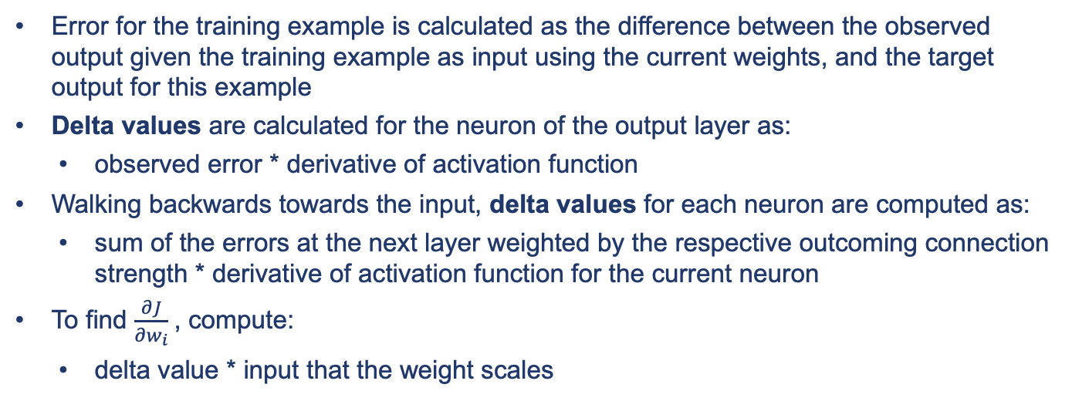
Backpropagation recap
Error for the training example is calculated as the difference between the observed output given the training example as input using the current weights, and the target output for this example
Delta values are calculated for the neuron of the output layer as:
observed error * derivative of activation function
Walking backwards towards the input, delta values for each neuron are computed as:
sum of the errors at the next layer weighted by the respective outcoming connection strength * derivative of activation function for the current neuron
To find $\frac{∂J}{∂w_{i}}$, compute:
delta value * input that the weight scales

Slide 50
Backpropagation summary
Michael Nielsen’s Neural Networks and Deep Learning - http://neuralnetworksanddeeplearning.com/chap2.html
Andrej Karpathy’s blog: https://karpathy.medium.com/yes-you-should-understand-backprop-e2f06eab496b
Chris Manning’s lecture - https://www.youtube.com/watch?v=yLYHDSv-288
Seminal Rumelhart et al. backpropagation paper - http://www.iro.umontreal.ca/~vincentp/ift3395/lectures/backprop_old.pdf

Slide 51
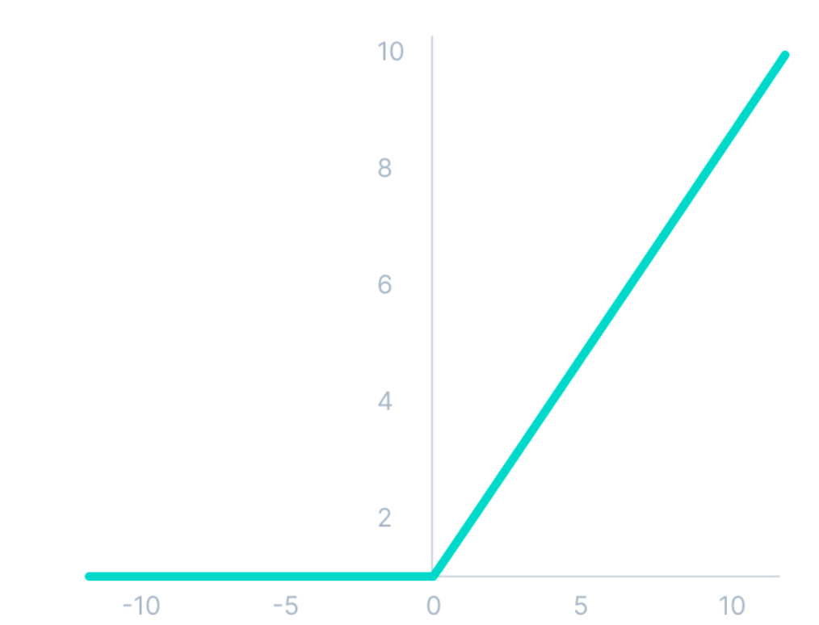
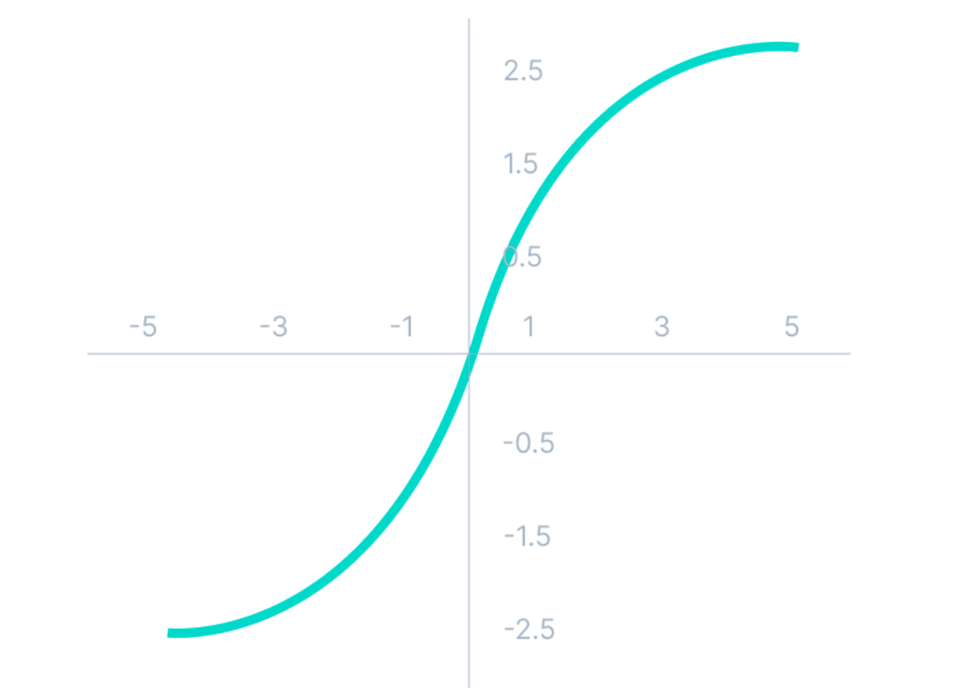
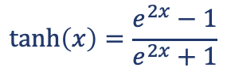
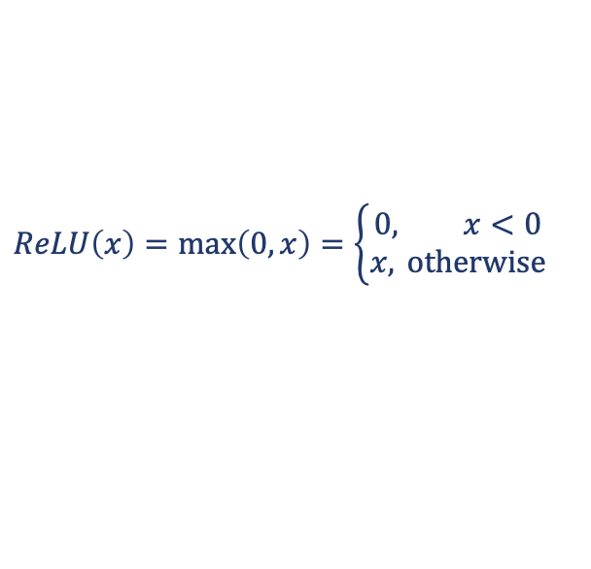
Non-Linearities
Rectified Linear Unit (ReLU) is a very simple activation function that clips each value x < 0 at 0
Very popular in MLP and CNN
Cheap to compute and helps with vanishing gradient
All the negative input values become zero -> weights for some neurons are not updated they become dead (= never activated)
Hyperbolic tangent (tanh) is an S-shaped activation function, transforming the values x into the range [−1, 1]
$$ReLU\left(x\right)=\max\left(0,x\right)=\left\{\begin{aligned}0, x<0 \\ &x, \text{otherwise}\end{aligned}\right.$$
$$\tanh\left(x\right)=\frac{e^{2x}−1}{e^{2x}+1}$$

Slide 52
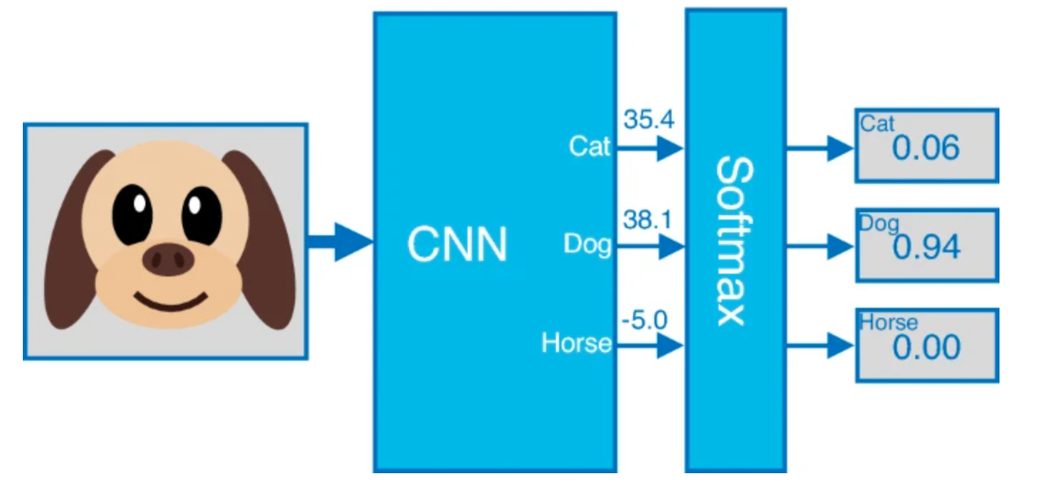
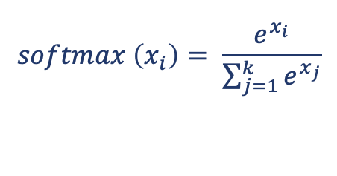

Softmax Activation for Output Layers
Softmax output transformation is used when we are interested in multi-class classification (mutually exclusive outputs)
Result: vector of non-negative real numbers that sum to 1, probability distribution over k possible classes
$$\text{x} =x_{1,}…,x_{k}$$
$$softmax \left(x_{i}\right)= \frac{e^{x_{i}}}{\sum_{j=1}^{k}{e^{x_{j}}}}$$
https://www.nature.com/articles/s41598-021-94691-7

Slide 53
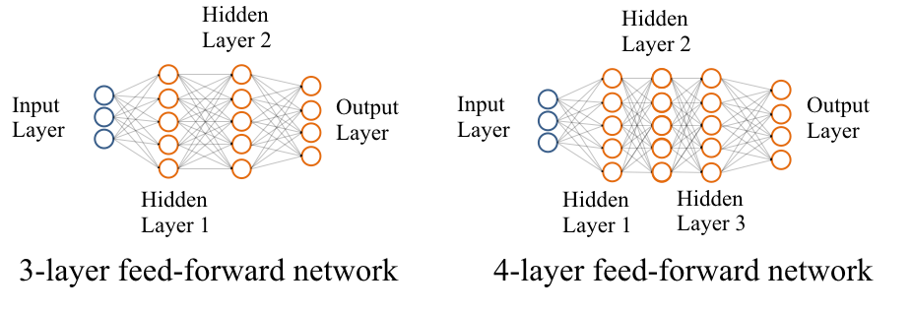
Deep neural networks
Deep networks are those with many hidden layers between input and output layers
Those hidden nodes do not directly receive inputs nor send outputs to external environment

Slide 54
Outline
Biological inspiration
Perceptron
Multilayer Perceptrons
Deep Learning
Training of Neural Networks
Convolutional Neural Networks

Slide 55
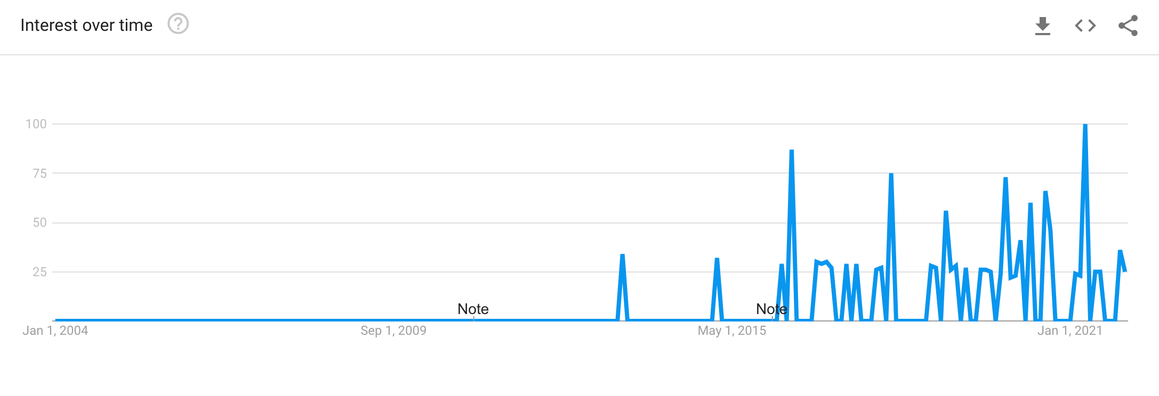
Deep Learning
Deep Learning is concerned with the development of multilayer artificial neural networks
Most of these algorithms were developed in the 80s or 90s
Why are these just becoming more popular in the last few years?
Large amounts of training data
Faster machines and multicore CPU/GPUs
New architectures, algorithms, ideas (representation learning, end-to-end and transfer learning)
Better regularisation and optimisation methods
Search “neural networks and deep learning” on Google trends. 2021. https://trends.google.com/trends

Slide 56
Pros & Cons
Increased performance
Opportunity to address complex problems
End-to-end modelling and flexibility
Dispensing with manual feature engineering via representation learning:
Feature engineering is the process of extracting characteristics from raw data using domain knowledge
But…
Lack of interpretability
May be difficult to model, train and tune
Prone to overfitting

Slide 57
Outline
Biological inspiration
Perceptron
Multilayer Perceptrons
Deep Learning
Training of Neural Networks
Convolutional Neural Networks

Slide 58
Hyperparameter search
Model parameters are estimated from data automatically
Model hyperparameters are set manually and are used in processes to estimate model parameters
They adjust the eﬀective ability of the model to reach lowest generalisation error
Generalisation error is measured on validation (development) set
Should be representative of the test data
In practise, a split of the training data
Many datasets come with predefined splits: to compare against existing work on the same dataset, you should use the same split as used in that work

Slide 59
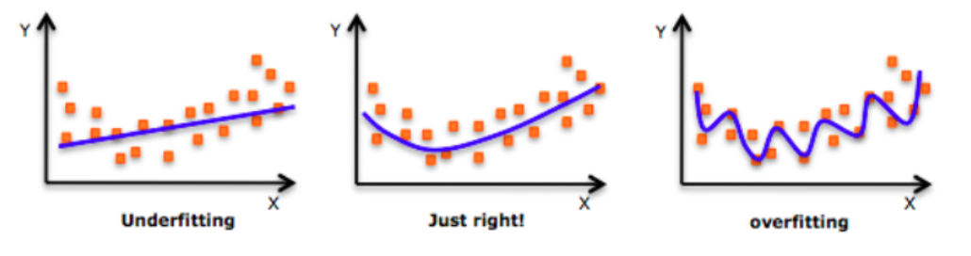
Hyperparameter Search
Two possible scenarios:
Underﬁtting - training & validation performances are low
Overfitting - training performance is high, but validation performance is low
https://www.analyticsvidhya.com/blog/2018/04/fundamentals-deep-learning-regularization-techniques

Slide 60
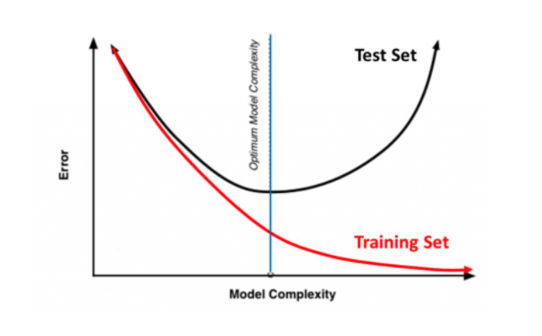
Hyperparameter Search
Optimal parameters are in the middle
Usually several main hyperparameters control the model performance
Need to learn these from experience
https://www.analyticsvidhya.com/blog/2018/04/fundamentals-deep-learning-regularization-techniques

Slide 61
Model capacity
Increasing model capacity can help generalise
Add more layers to your network
Add more hidden units
This helps to overcome underfitting
But can lead to overfitting
Important hyperparameters:
Learning rate
Patience (for early stopping)
Dropout rate
Number of hidden layers, hidden state dimensionality

Slide 62

Learning rate
High learning rate → loss can "bounce around" and overshoot the optimum
Small learning rate → optimisation will take longer but increases chance to find optimum
Adam (instead of SGD) is better optimiser: more forgiving to hyperparameters
Use a learning rate schedule: varying the learning rate over the training process
“If you have time to tune only one hyperparameter, tune the learning rate.”
Goodfellow, Bengio and Courville. Deep Learning, 2016
https://www.deeplearningwizard.com/deep_learning/boosting_models_pytorch/lr_scheduling/

Slide 63

Early stopping
Recommended base technique to overcome overfitting
Stop training process when the validation loss reaches a plateau or starts to increase
Patience is the number of epochs with no further improvement after which the training will be stopped
https://stanford.edu/~shervine/teaching/cs-230/cheatsheet-deep-learning-tips-and-tricks

Slide 64

Dropout
At training, ignore (zero) some number of layer outputs
Makes the training process noisy, forcing the network to rely only on partial information
Dropout is implemented per-layer
E.g. value = 0.5
Can be used on most types of layers: fully connected, convolutional and recurrent layers
On any or all hidden layers and the input layer
Not on the output layer
Dropout at test time has different uses

Slide 65
Outline
Biological inspiration
Perceptron
Multilayer Perceptrons
Deep Learning
Training of Neural Networks
Convolutional Neural Networks

Slide 66

Convolutional Neural Networks
Convolutional Neural Networks (CNNs) have been very successful in computer vision
Object detection has been one of the most difficult problems in AI: draw a bounding box around each object and predict its class
AlexNet deep architecture was the winner of the ImageNet 2012 competition with a Top-5 error rate of 15.3%
Classify 1000+ objects
State-of-the-art before 2012: ~26% error
Krizhevsky, Sutskever & Hinton. (2012). ImageNet Classification with Deep Convolutional Neural Networks, NIPS.

Slide 67



Convolutional Neural Networks
Standard fully-connected layers are not suitable for images:
Assume grayscale image (1 channel) of resolution 256x256
Single neuron connected to all pixels will require 65K params
If first layer has 128 of those neurons, we will have in total 65K*128~8.4M params
Loss of spatial information: we need to be able to detect patch no matter where it may appear
Convolutional Neural Networks are inspired by the models of visual cortex in neuroscience:
In those models, receptive field of a neuron is the portion of sensory input that affects neuron’s activation
http://www.wildml.com/2015/11/understanding-convolutional-neural-networks-for-nlp/

Slide 68

Convolutional Neural Networks
Convolution applies a sliding window function (a.k.a. kernel, filter, or feature detector) to the image matrix:
It describes how each pixel will be influenced by its neighbours and extracts relevant features
Typical size 3x3 or 5x5 – parameter reduction and robust to feature location
https://towardsdatascience.com/simple-introduction-to-convolutional-neural-networks-cdf8d3077bac
http://www.wildml.com/2015/11/understanding-convolutional-neural-networks-for-nlp/

Slide 69

Convolutional Neural Networks
CNN learns values of its filters based on task. For example, for object detection:
Each CNN layer learns filters of increasing complexity
1st layer: learn to detect edges from raw pixels; 2nd layer: use the edges to detect simple shapes
Higher layers: use these shapes to detect higher-level features, like facial shapes
Last layer: classifier that uses these high-level features
https://www.cc.gatech.edu/~hays/compvision2017/proj6/deepNetVis.png

Slide 70
Convolutional Neural Networks
2 x 2 filter
0 | 1
2 | 3
2D Convolution Layer:
E.g. 2x2 filter over pixel representation of an image
Dot product with the original matrix
Do this for each element by sliding the filter over the whole matrix
Result is a feature map
Typically, a nonlinear layer is applied after each convolution layer (e.g., ReLU activation)
0×0+1×1+3×2+4×3=19
0 | 1 | 2
3 | 4 | 5
6 | 7 | 8
19
Image
Feature map

Slide 71
Convolutional Neural Networks
2 x 2 filter
0 | 1
2 | 3
1×0+2×1+4×2+5×3=25
0 | 1 | 2
3 | 4 | 5
6 | 7 | 8
19 | 25
1 x 1
Stride size (s) - how much to shift the filter at each step

Slide 72
Convolutional Neural Networks
2 x 2 filter
0 | 1
2 | 3
3×0+4×1+6×2+7×3=37
0 | 1 | 2
3 | 4 | 5
6 | 7 | 8
19 | 25
37

Slide 73
Convolutional Neural Networks
2 x 2 filter
0 | 1
2 | 3
4×0+5×1+7×2+8×3=43
0 | 1 | 2
3 | 4 | 5
6 | 7 | 8
19 | 25
37 | 43

Slide 74
Convolutional Neural Networks
2 x 2 filter
0 | 1
2 | 3
0 | 1 | 2
3 | 4 | 5
6 | 7 | 8
input size - 𝑛_{ℎ}×𝑛_{𝑤} kernel size - k_{ℎ}×k_{𝑤}
stride size - s_{ℎ}×s_{𝑤}
19 | 25
37 | 43
(𝑛_{ℎ}−𝑘_{ℎ}+𝑠_{ℎ}) / 𝑠_{ℎ} ×(𝑛_{𝑤}−𝑘_{𝑤}+ 𝑠_{w}) / 𝑠_{w}
(3−2+1) / 1 ×(3−2+1) / 1 = 2 × 2

Slide 75
Convolutional Neural Networks
3
2 x 2 filters
0 | 1
2 | 3
input size - 𝑛_{ℎ}×𝑛_{𝑤} kernel size - k_{ℎ}×k_{𝑤}
stride size - s_{ℎ}×s_{𝑤}
0 | 1 | 2
3 | 4 | 5
6 | 7 | 8
19 | 25
37 | 43
3 feature maps
(𝑛_{ℎ}−𝑘_{ℎ}+𝑠_{ℎ}) / 𝑠_{ℎ} × (𝑛_{𝑤}−𝑘_{𝑤}+ 𝑠_{w}) / 𝑠_{w} × c_{f}
2 × 2 x 3

Slide 76
Convolutional Neural Networks
2 x 2 max pooling
Pooling Layer
Pooling layers subsample from the window over feature maps, e.g. by max (or avg) pooling
Dimensionality reduction
max(0,1,3,4)=4
5 | 6 | 7
3 | 4 | 3
9 | 2 | 5
6
Feature map
Output

Slide 77
Convolutional Neural Networks
2 x 2 max pooling
max(6,7,4,3)=7
5 | 6 | 7
3 | 4 | 3
9 | 2 | 5
6 | 7

Slide 78
Convolutional Neural Networks
2 x 2 max pooling
max(3,4, 9, 2)=9
5 | 6 | 7
3 | 4 | 3
9 | 2 | 5
6 | 7
9

Slide 79
Convolutional Neural Networks
2 x 2 max pooling
max(4, 3, 2, 5)=5
5 | 6 | 7
3 | 4 | 3
9 | 2 | 5
6 | 7
9 | 5

Slide 80
Convolutional Neural Networks
Several convolutional layers are typically applied sequentially
They are followed by fully connected layers and output layers
0 | 1 | 2
3 | 4 | 5
6 | 7 | 8
43
19 | 25
37 | 43
Convolution
Pooling
Output layer

Slide 81
Take-Home Messages
Neural networks are complex nonlinear models inspired by the structure and function of the brain
Deep learning concerns networks with many layers of neurons that can identify and learn complex patterns by adjusting their weights
Weights are adjusted by the training algorithm to minimise the loss using calculus (gradient descent and backpropagation algorithms)
Convolutional neural networks capture multiple aspects of an image at each spatial location
Deep Learning works especially well for visual object recognition, speech recognition, natural language processing and reinforcement learning in complex environments
A major weakness of neural networks is their inability to explain outputs (hidden nodes and weights have no individual, explicit meaning)

